Slide 1
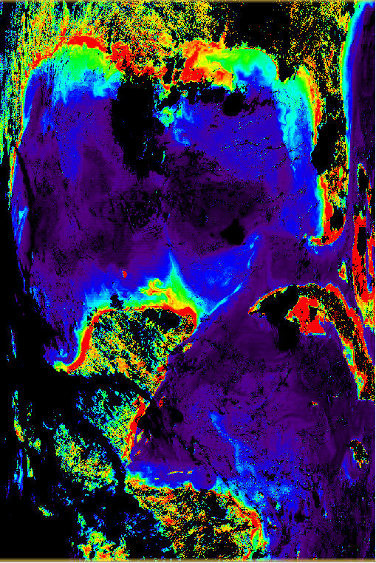
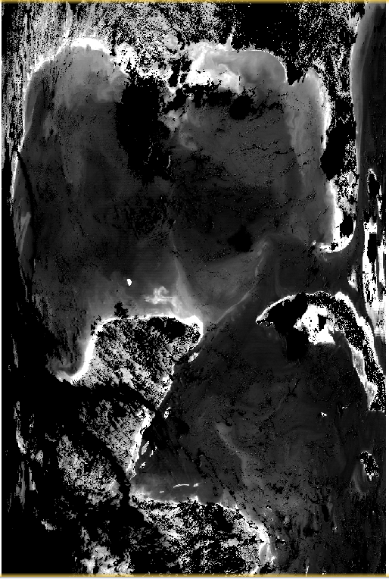
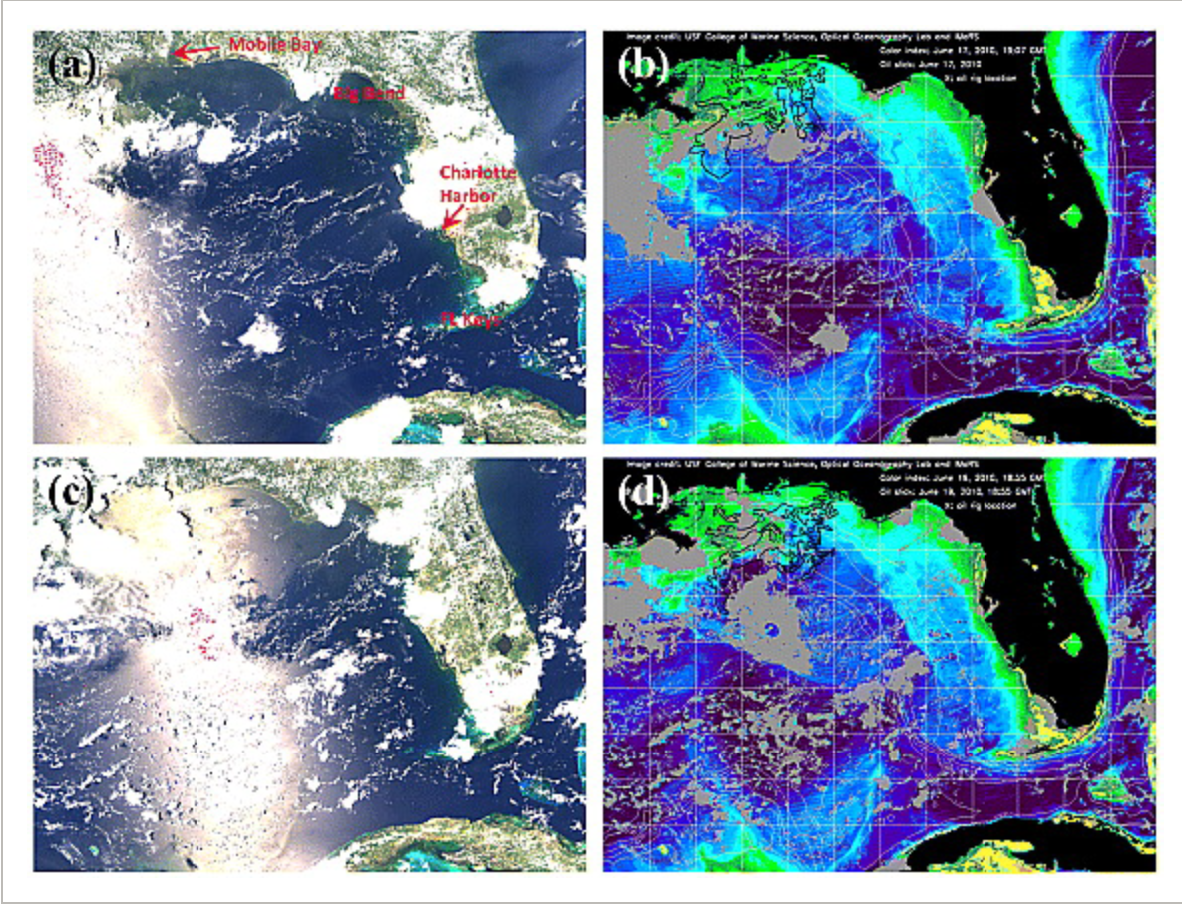
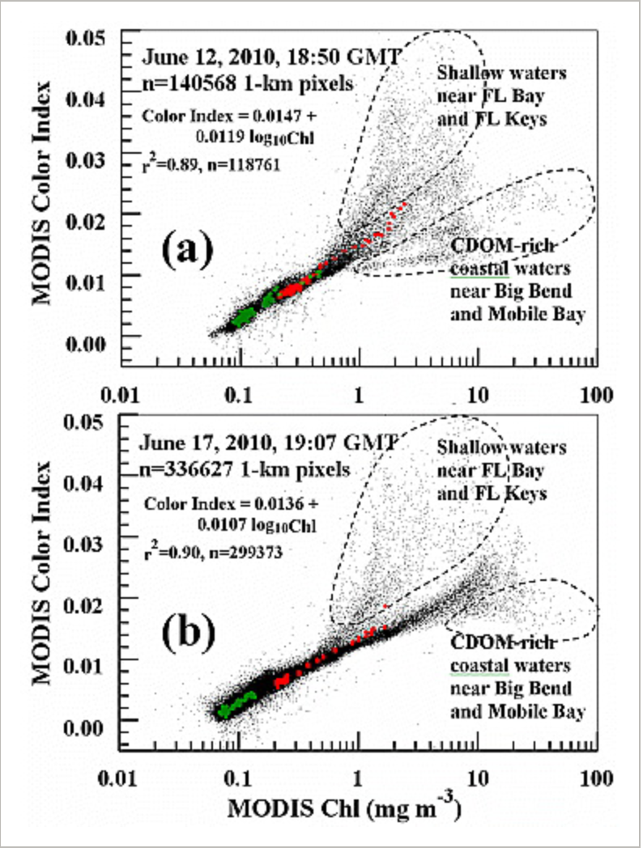
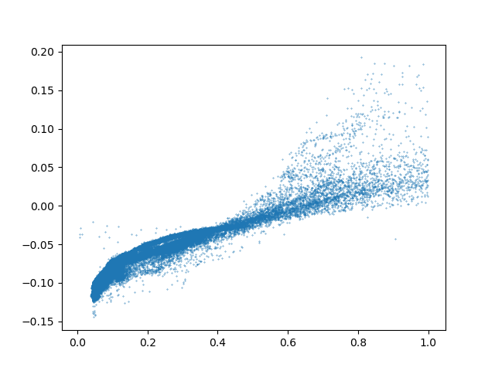
Some example works during working time
Input image in R,G,B bands
CI in False Color
CI in Grey Scale
Hu, Chuanmin. "An empirical approach to derive MODIS ocean color patterns under severe sun glint." Geophysical Research Letters 38.1 (2011).
Reference results in the original paper
Correlation with chlor_a

Slide 2
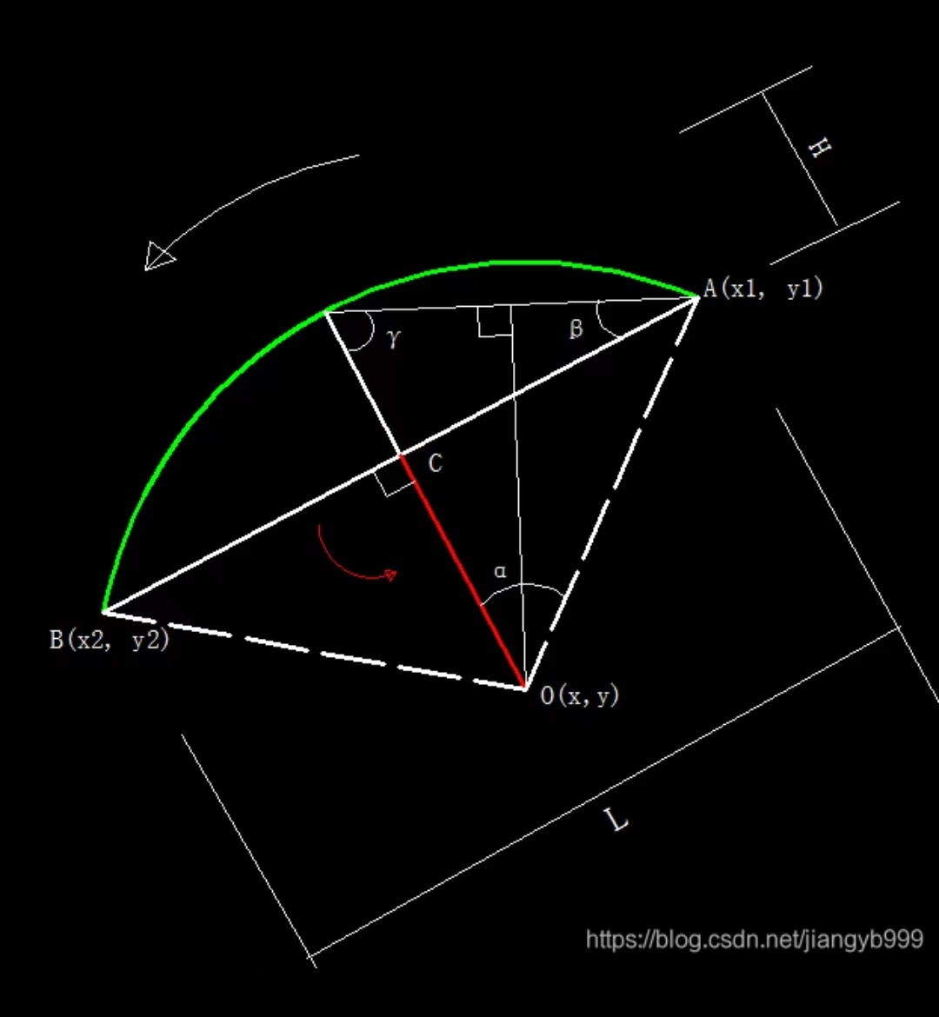
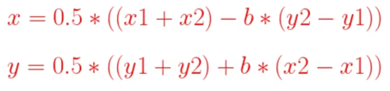
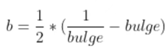
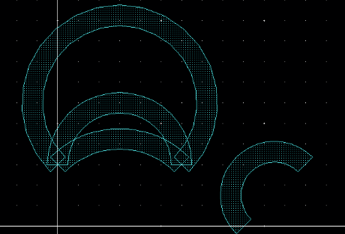
EDA
bulge = 2H/L = tan(beta)= tan(alpha/2)
Basic Primitives---Arc

Slide 3
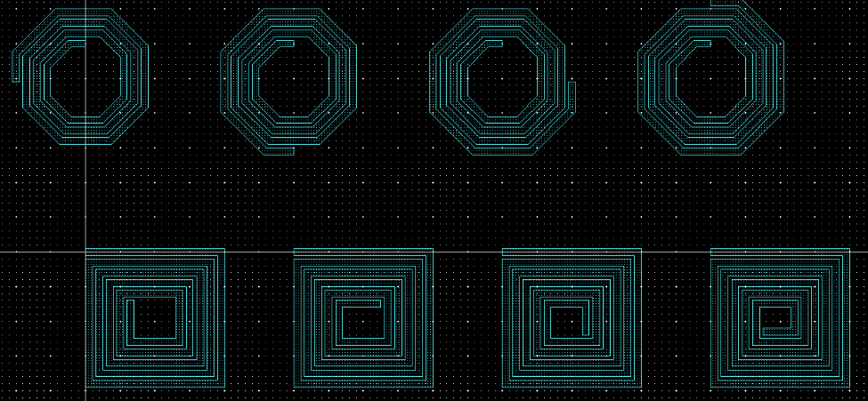
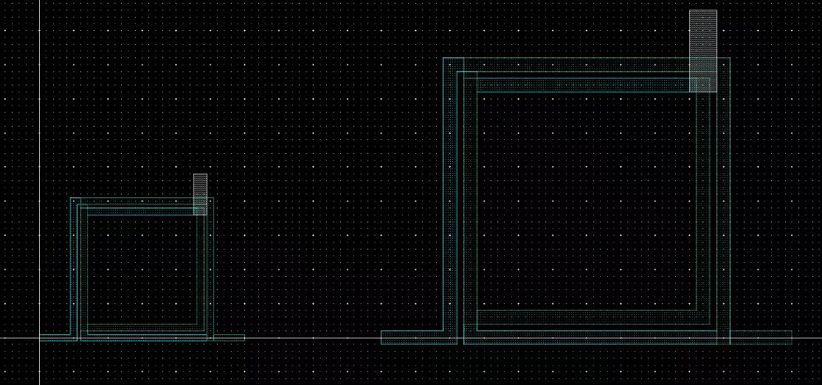
Advanced Primitives---Spiral Shape (Octagon, Square, Circle, Tcoil)
point1
r
Inlen/2+pitch
pitch
point1
pitch
outlen/2
r
Tcoil

Slide 4
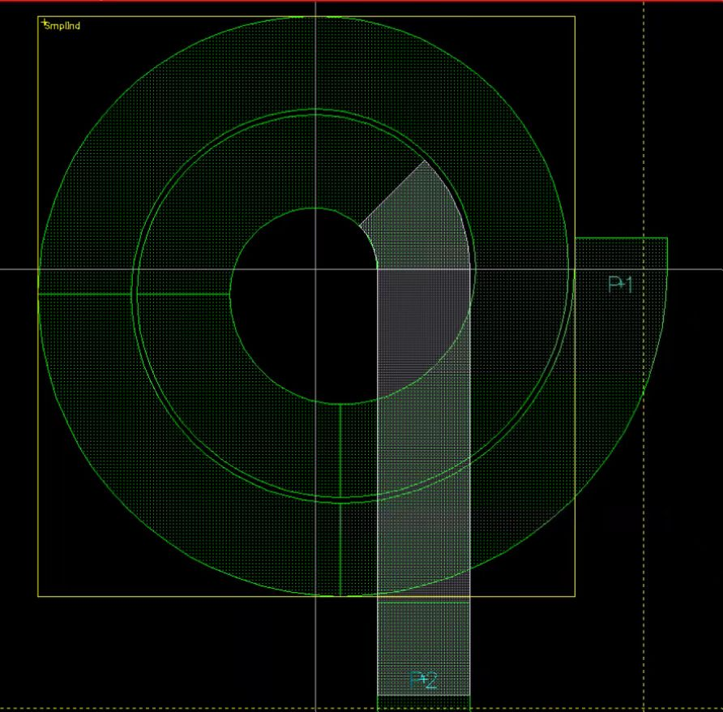
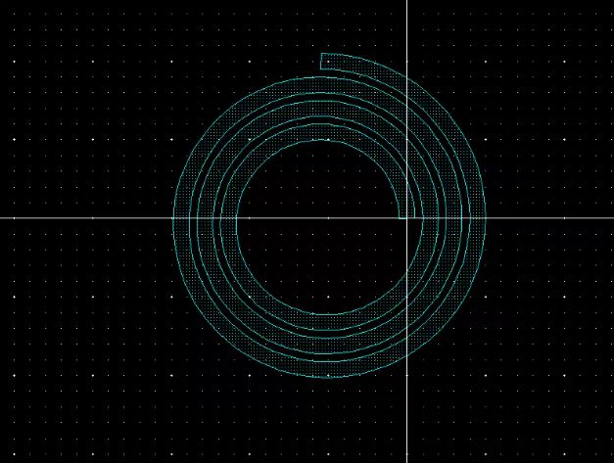
start center
pitch/4.0
pitch

Slide 5
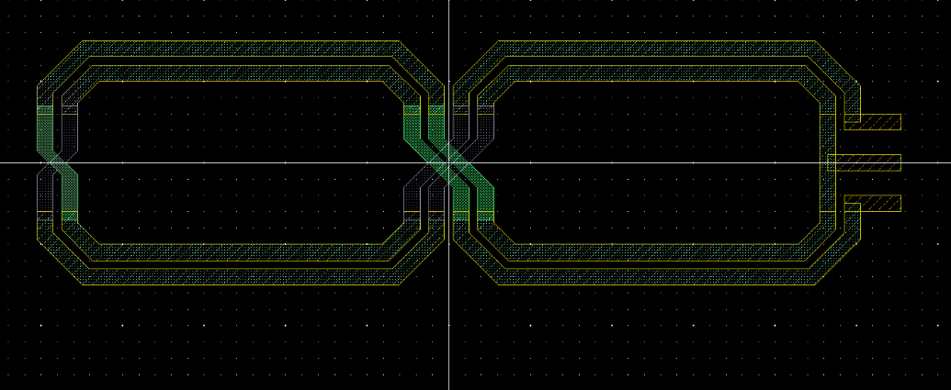
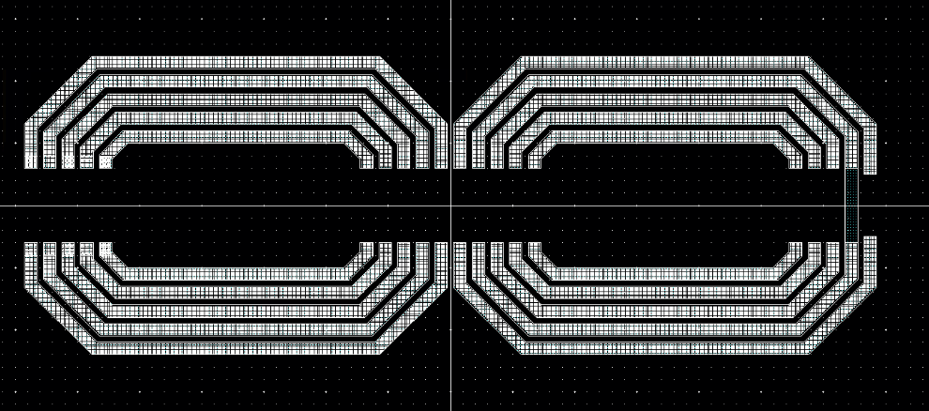
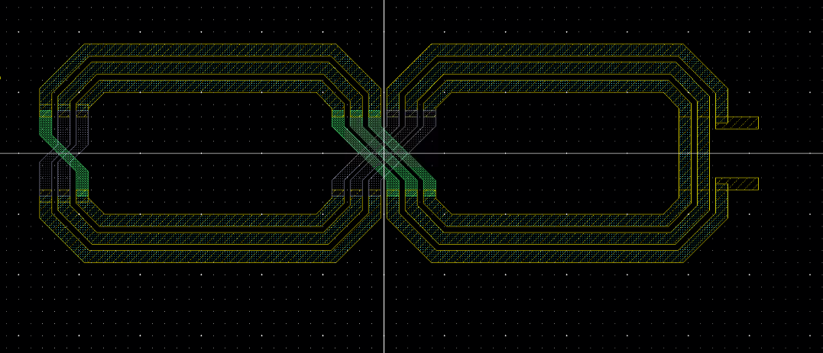
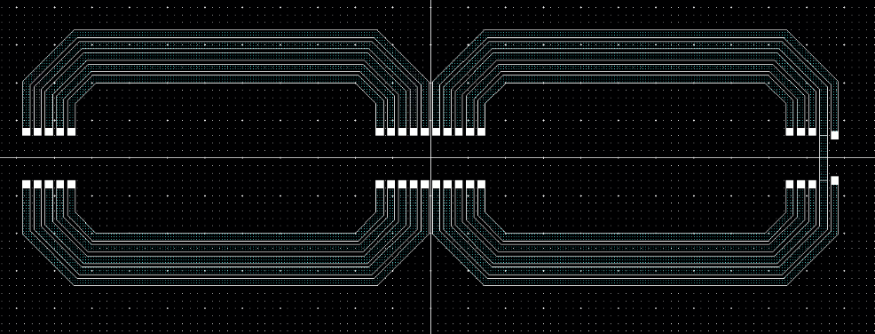
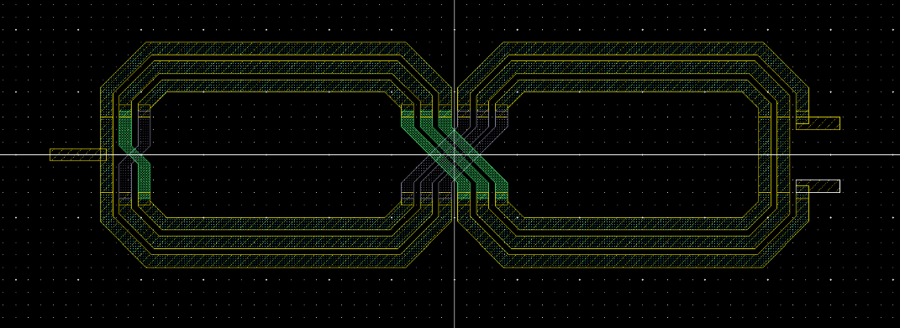
BowTie Inductor
Shape ajustment
（aspect_ratio, side_extension…）
deltax = deltay = pitch/tan(rad(22.5))
pitch
Inlen/2
(x_center, y_center)
(x_ori, y_ori)

Slide 6
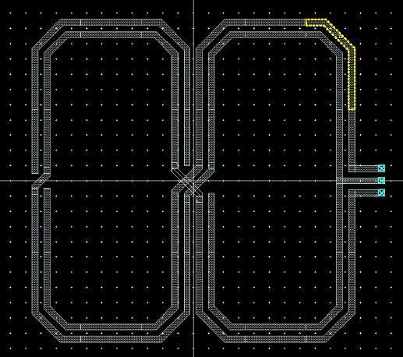
yinlen/aspect_ratio - yinlen
Adding aspect_ratio
ePCD1.0 BowTie Inductor

Slide 7
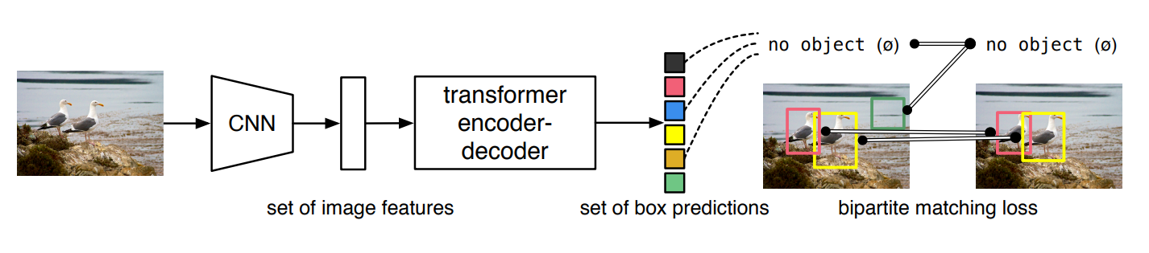
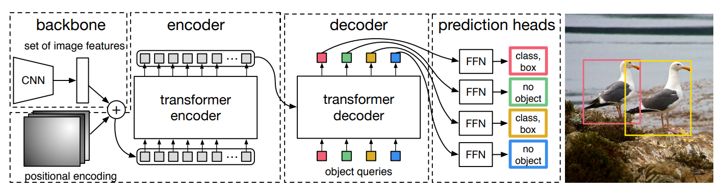
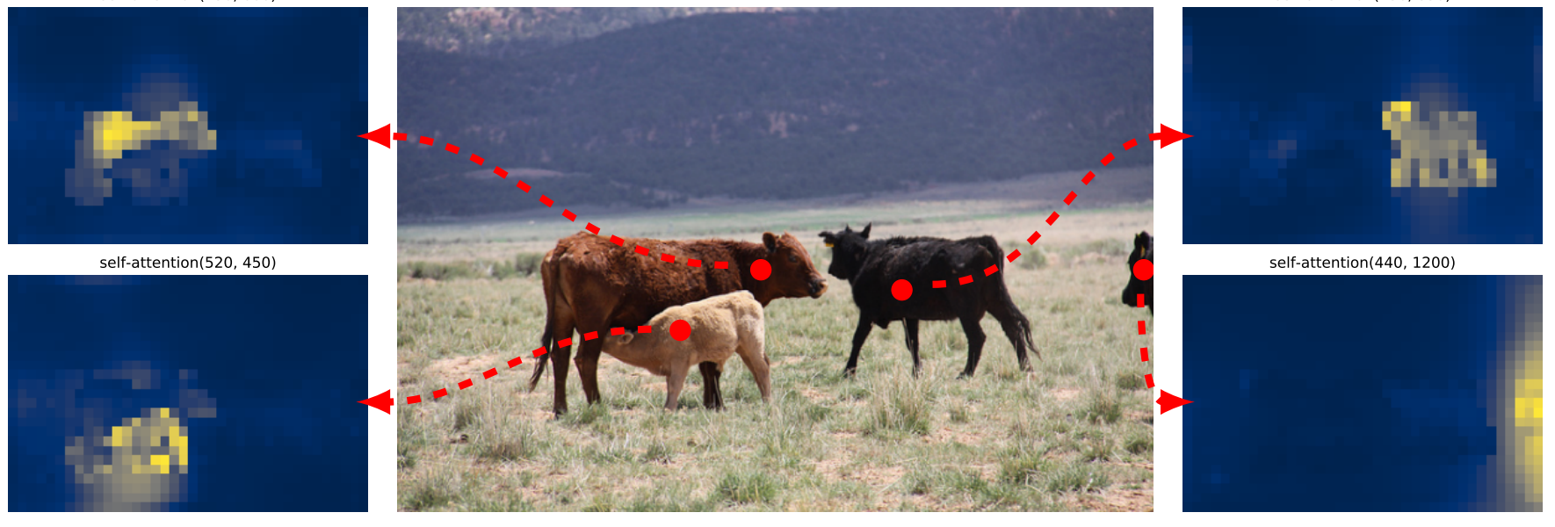
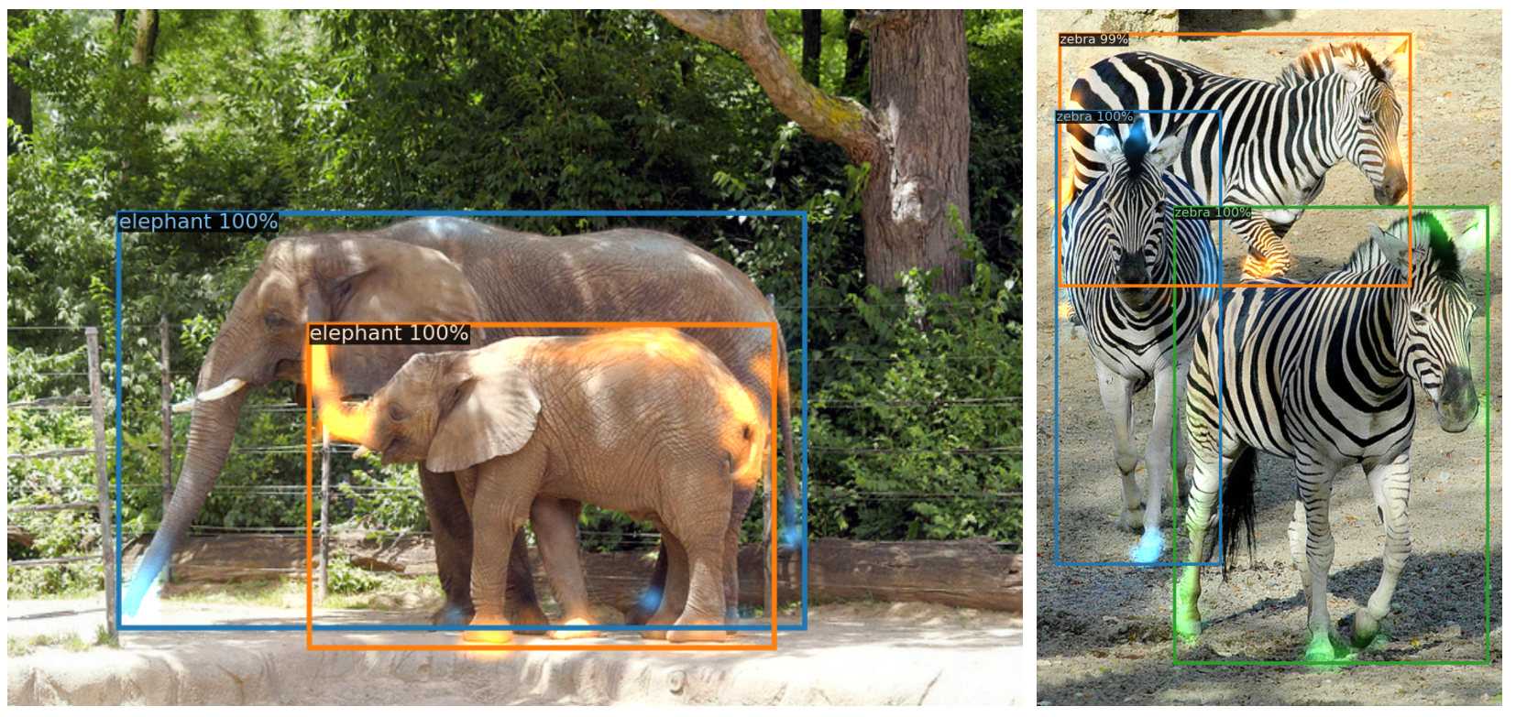
DETR-series object detection----based on which I intend to conduct some experiments
Carion, Nicolas, et al. "End-to-end object detection with transformers." Computer Vision–ECCV 2020: 16th European Conference, Glasgow, UK, August 23–28, 2020, Proceedings, Part I 16. Springer International Publishing, 2020.

Slide 8
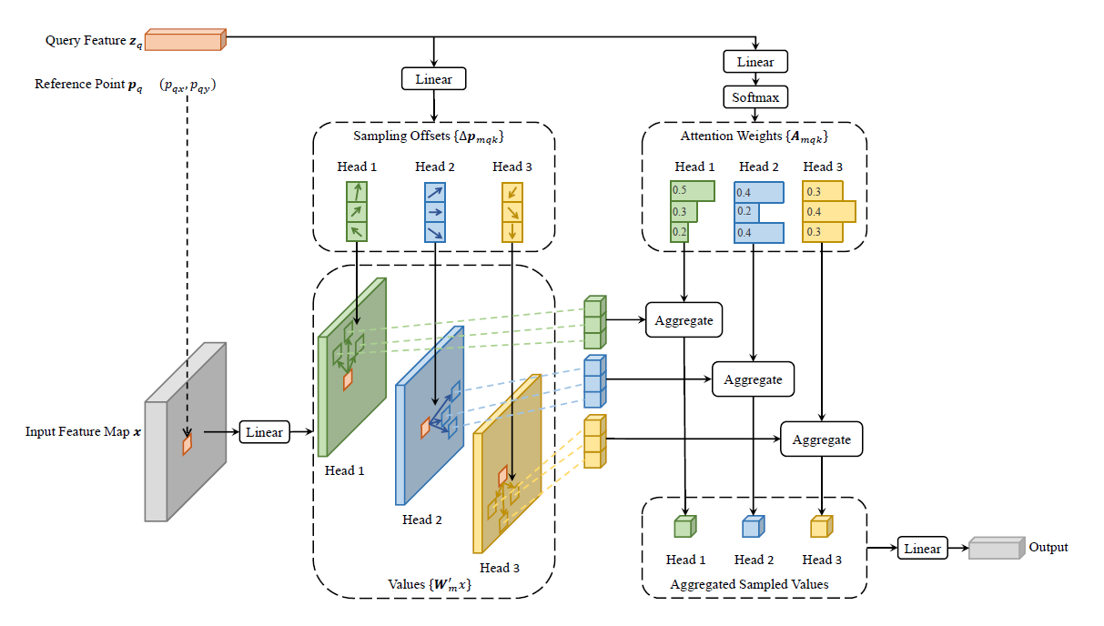
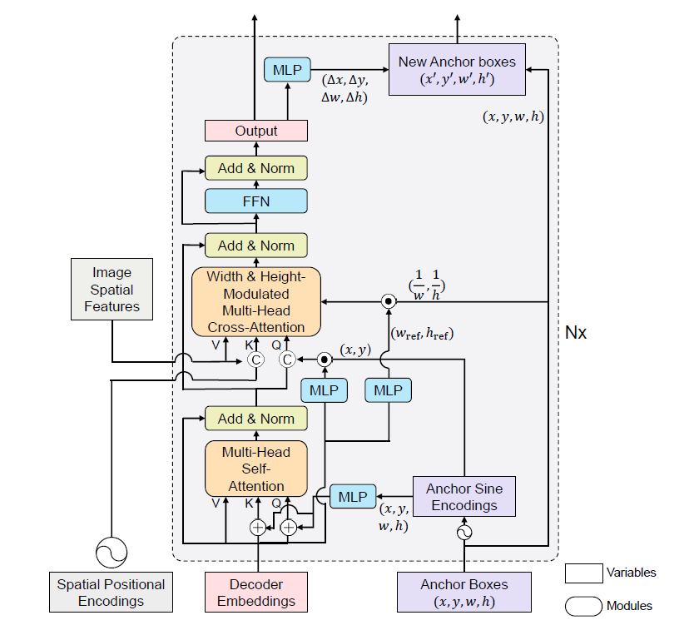
Deformable DETR
DAB-DETR
Zhu, Xizhou, et al. "Deformable detr: Deformable transformers for end-to-end object detection." arXiv preprint arXiv:2010.04159 (2020).
Liu, Shilong, et al. "Dab-detr: Dynamic anchor boxes are better queries for detr." arXiv preprint arXiv:2201.12329 (2022).

Slide 9
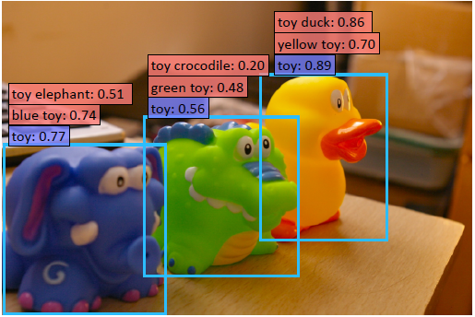
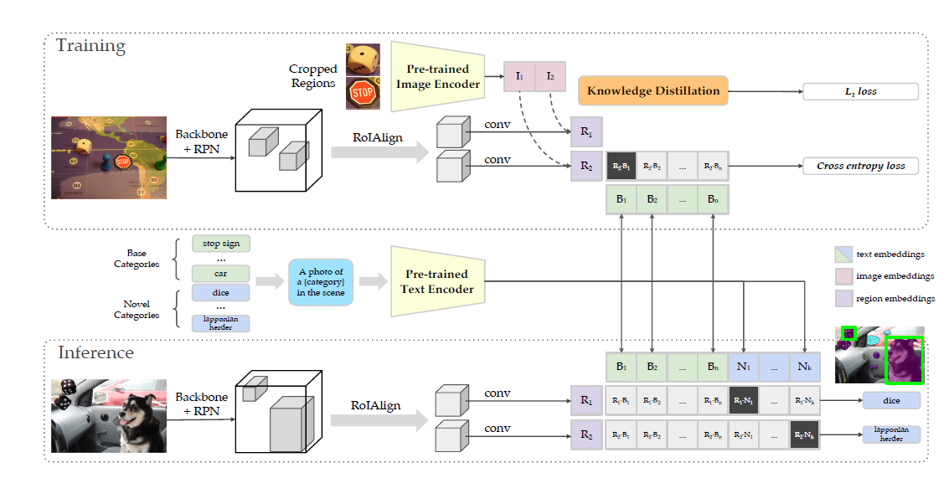
Open-set recognition
Gu, Xiuye, et al. "Open-vocabulary object detection via vision and language knowledge distillation." arXiv preprint arXiv:2104.13921 (2021).

Slide 10
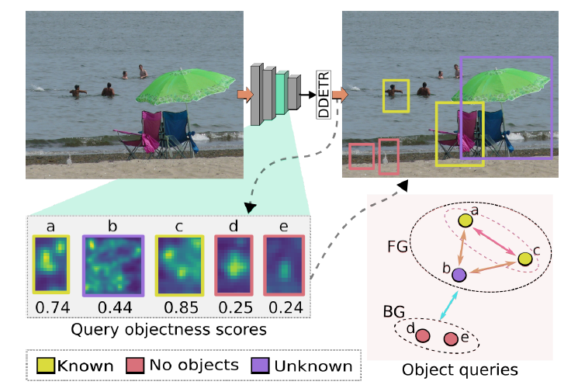
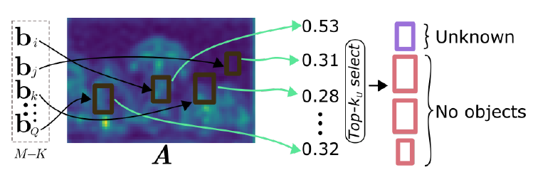
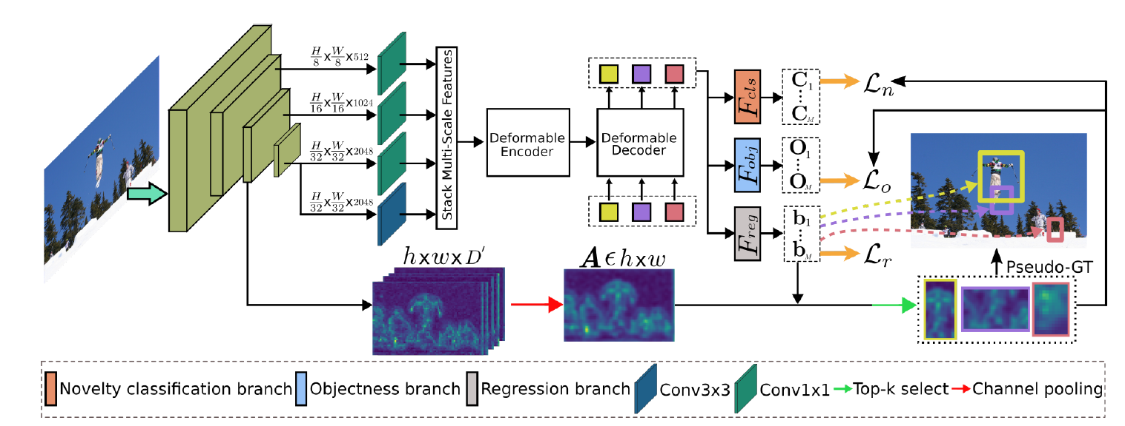
Gupta, Akshita, et al. "Ow-detr: Open-world detection transformer." Proceedings of the IEEE/CVF Conference on Computer Vision and Pattern Recognition. 2022.

Slide 11
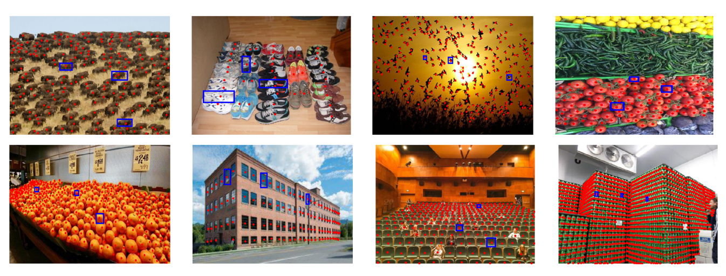
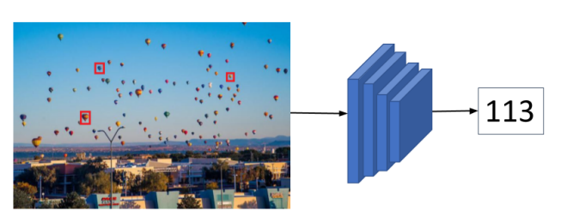
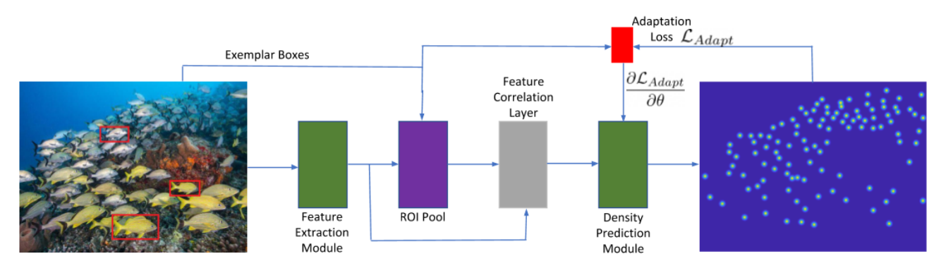
Class agnostic vision tasks(visual counting, pose estimation, etc.)
Ranjan, Viresh, et al. "Learning to count everything." Proceedings of the IEEE/CVF Conference on Computer Vision and Pattern Recognition. 2021.

Slide 12
The topics I am studying:
AIGC
Vision/multi-modality foundation model
Reinforcement Learning and Multi-agent Reinforcement Learning
Federated Learning(Personalization, trustworthy FL)
Machine Learning with Graphs
etc.

